Slide 1
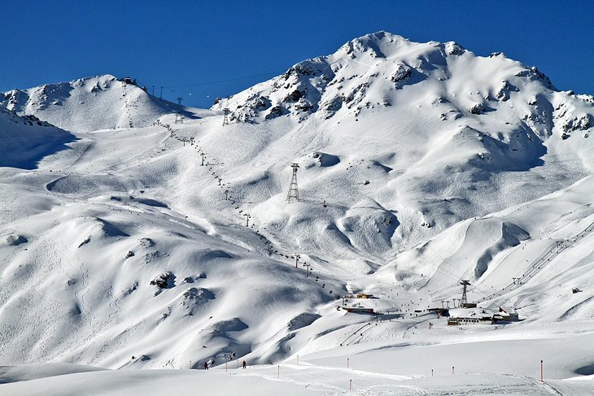



Ski plan made easy and sustainable
Notes:
Can we add mountain and ski vector to the logo….. With colors…

Slide 2
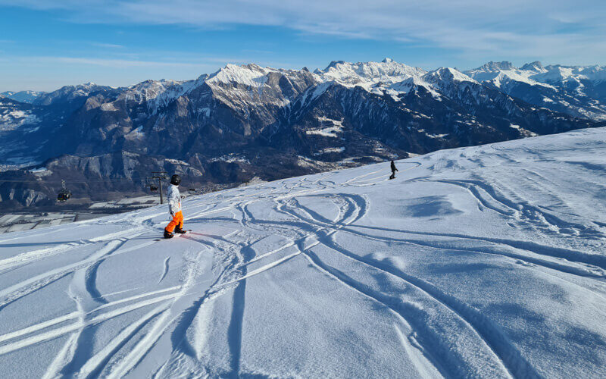








Skiing should be easy and enjoyable, but but but !!!
Ski, finally!
Rentals?
Where to eat though?
Queue for Tickets
Drive
Aah crap, this weather!
Weather info…
Too long queue
Messy digital journey
“Aah, Is there powder ?”
“I do not want to spend 30-45 mins buying tickets or rental”
“Why do I have to go to all different resorts websites to get this info”
Notes:
Problems..... What if….!!!!
In Switzerland:

Slide 3

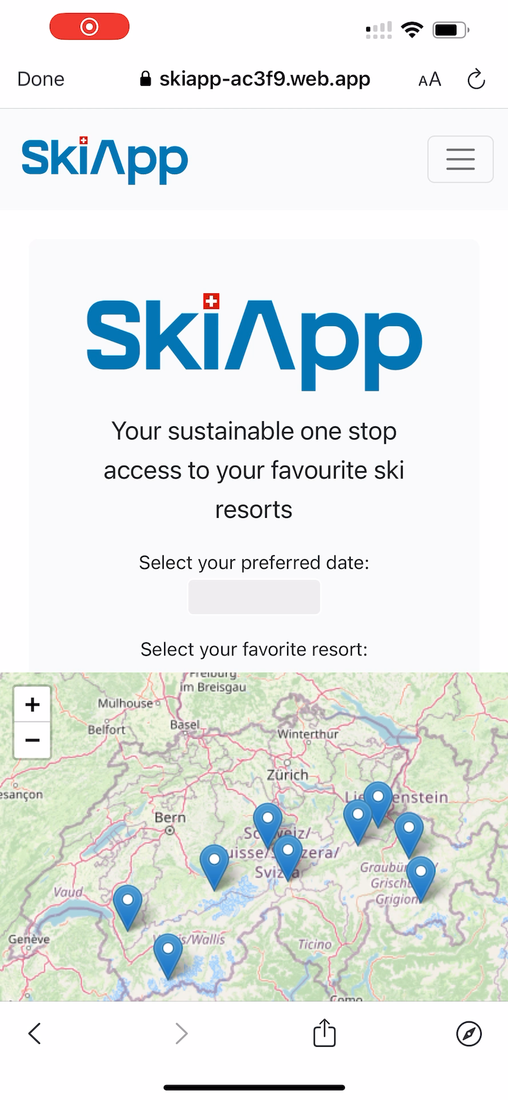

All now information
Convenience
Buy a ski pass
Saves time
Interactive map
Best Price
Equipment Rentals
Aperi-Ski
More ski time
Notes:
What if we bring you all the convenience you need for a ski plan, in 1 place…. We give you – SkiApp…. 1. An app, which gives you all ski resorts data, at a fingertip to you….
2. You got live weather updates to easily plan your ski trip
3. Oner click buy ski pass option…. So you do not have to waste your half hour in the queue…
4. Interactive map of all the ski slopes
5. Rental equipment ordering to avoid lead times at the shop
6. And if that’s not enough, it also tells you all the aperi shi’s happening around Wait, there’s more – We even provide with you the recommendations on the most eco-friendly ski resorts, so you can also make conscious choices….
Who would not want a ski trip like that.!!!!

Slide 4








A clean 1.5million CHF opportunity, dying to be realized
100m CHF
DE/AT/CH/FR market
Expand
1.5m CHF
Swiss market alone
Onboard resorts
Drive adoption
1% commission on ski passes and rental
Notes:
Monetization business model….
It is a 1.5 million serviceable opportunity only in Switzerland…. Which can be upto 100million if expanded geographically, and even more if expanded to seasons.
GTM strategy…. Timeline???

Slide 5
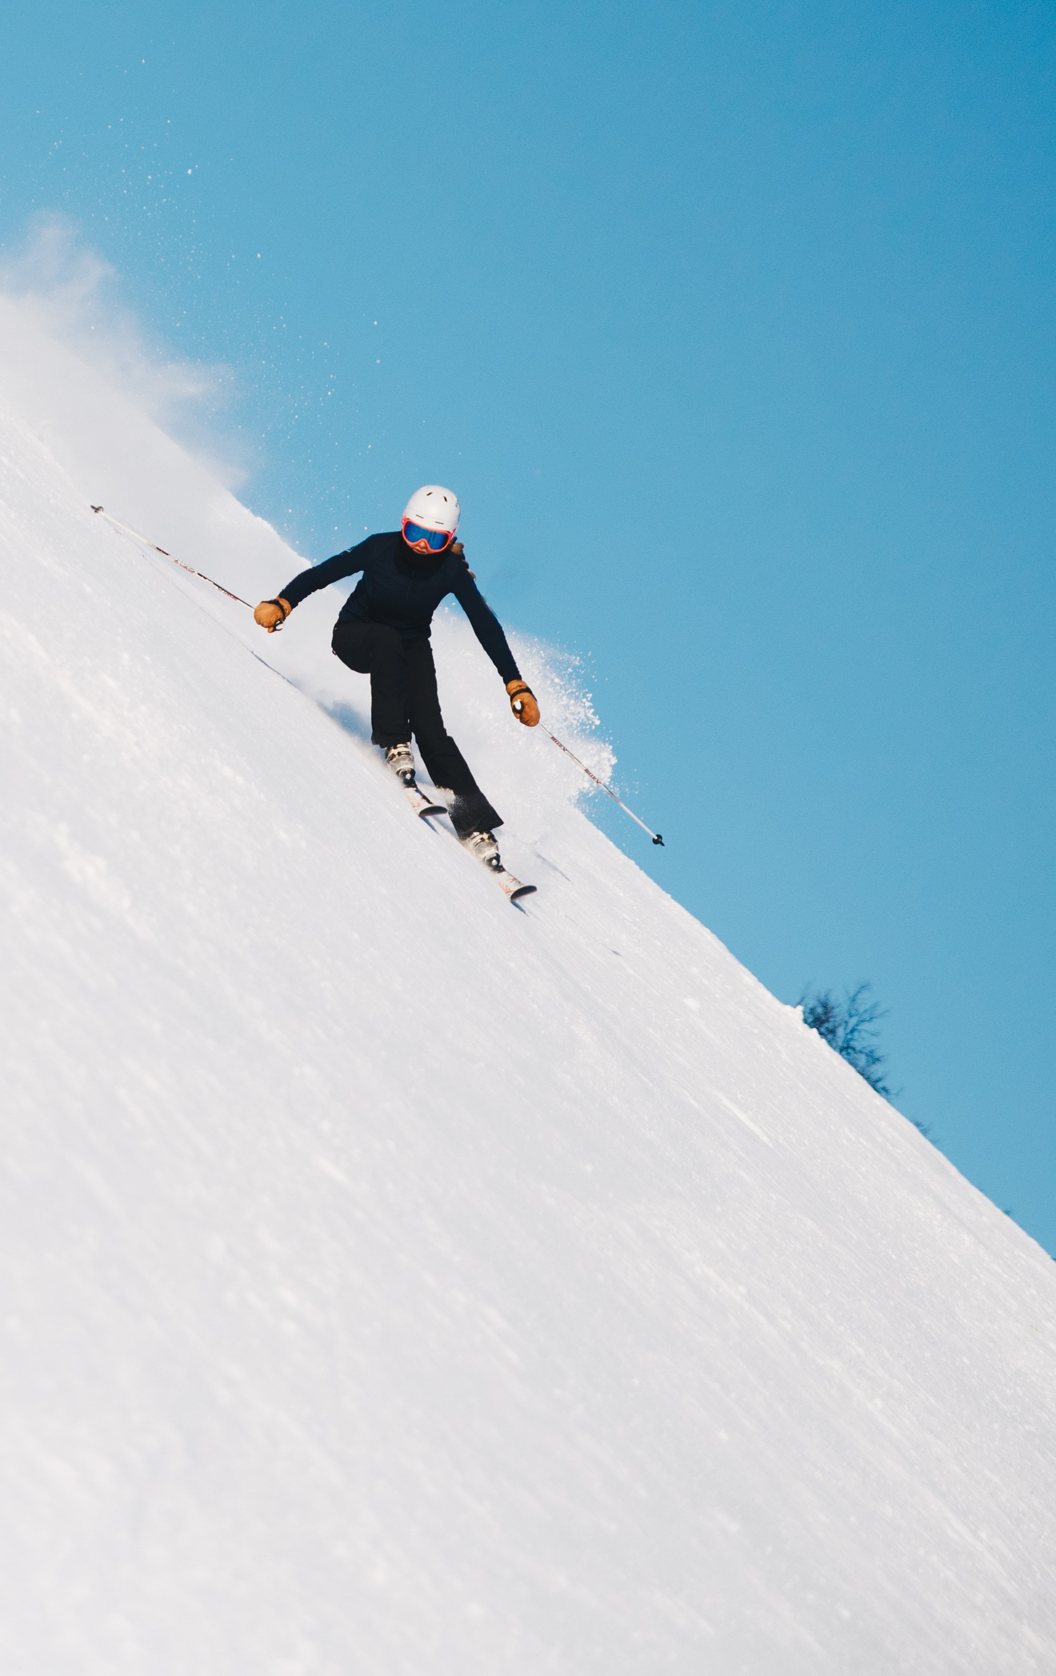







Why is this still not addressed!!!
5
Notes:
What tech we used….!!!
Challenges we faced…. And next steps…
But hey, not all solutions need to be complicated, some need to solve real issues as well. As Einstein said: Simple solutions are often the right ones.

Slide 6
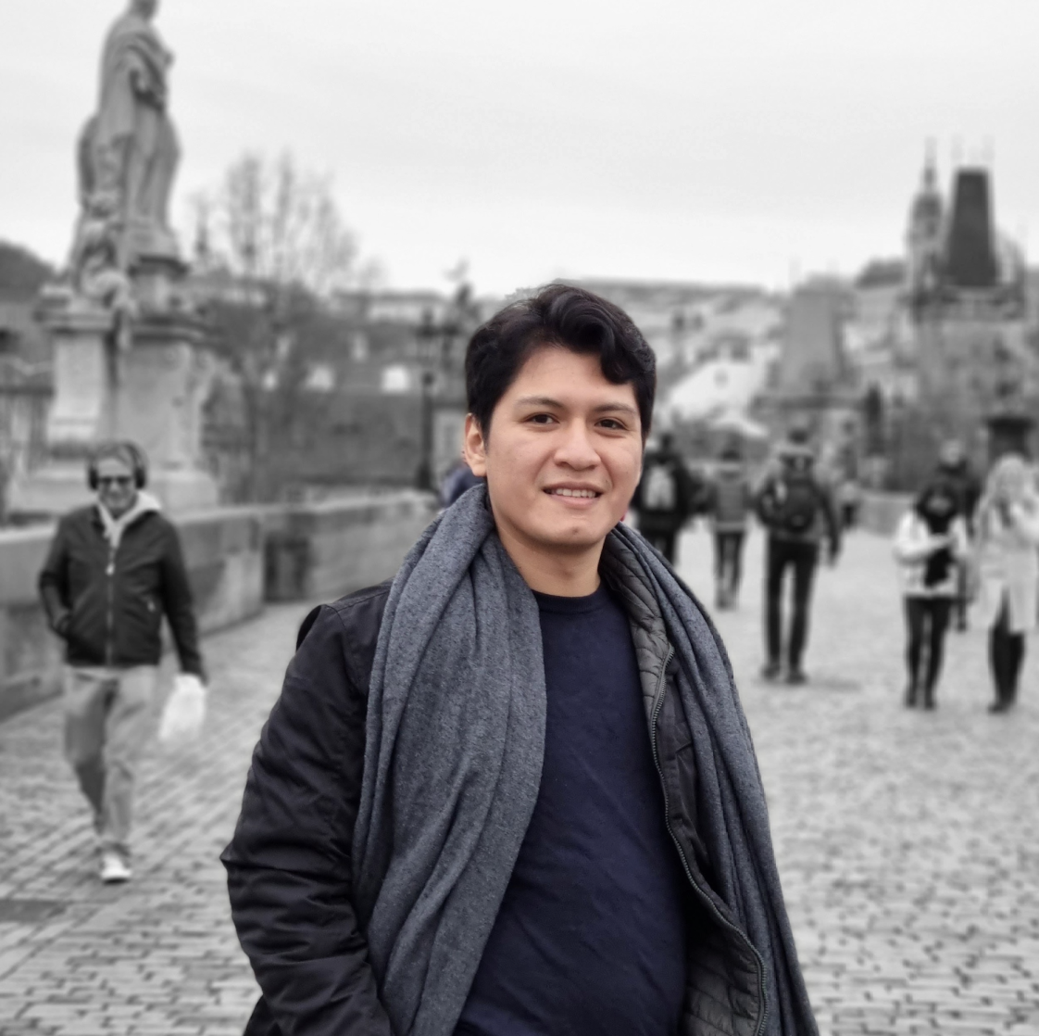
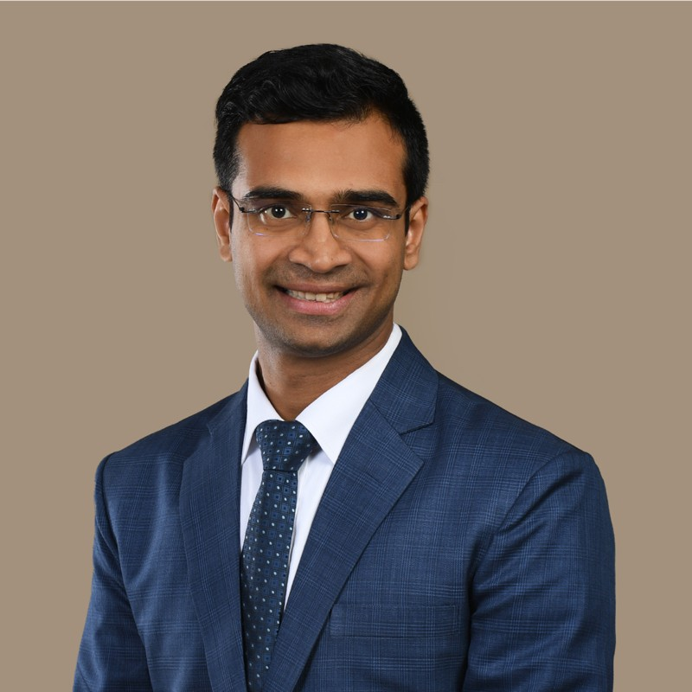
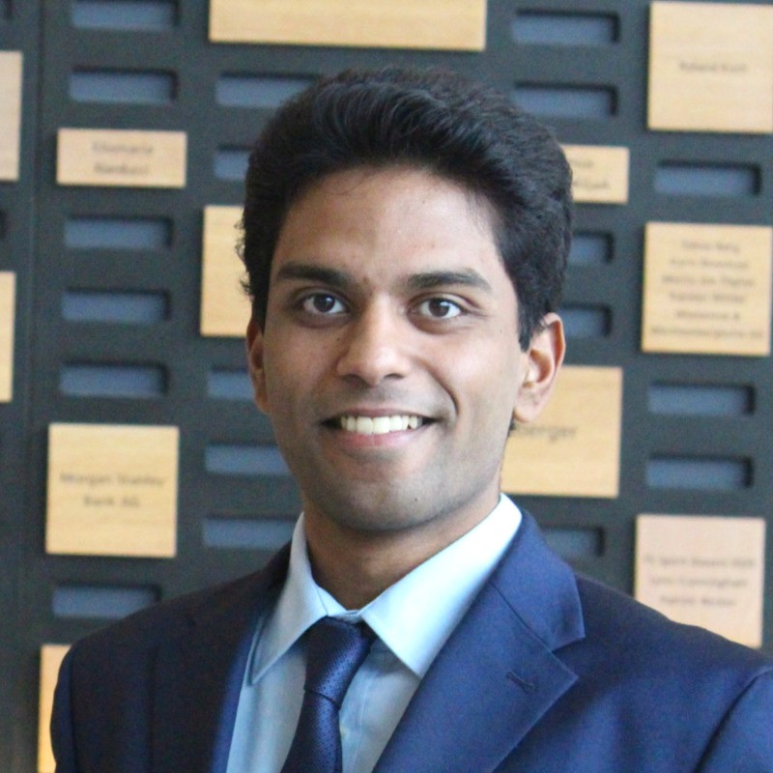















Team with right ski experience, business and technical expertise to make skiing simpler.
Diego NUÑEZ
Navanshu AHUJA
Suriyaa Rocky SUNDARARUBAN
Ski experience
1.5 years | 6 years | 1 year
Full stack engineer | Business strategy | Entrepreneurship
B.Sc. Computer Science | MBA + Engineering | Management & Technology
Side hustle
Qualifications
Ideation credits
Robin + Matthias + others
HSG MBA
Notes:
Change a to Caret symbol….
Our Team….
We are just not any hackers, we are avid skiers…. X years experience in skiing….
Side hustle: Business strategy Qualifications: MBA, HSG etc….
Appeal….
Join us, if you’d want to make your ski travel , EASY and Sustainable.

Slide 7
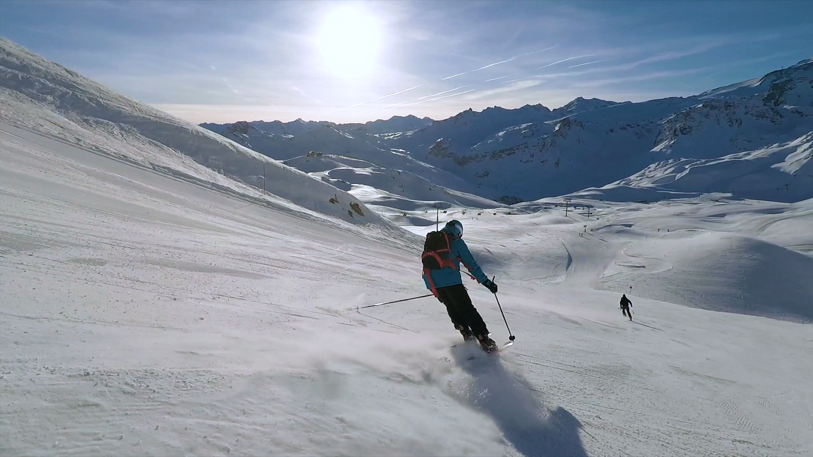


Convenience
Bootstrap
Sustainable recommendations
Join Us - In making easy ski plans, a reality.

